Slide 1
Sort Algorithms
Efficiency and Analysis

Slide 2
Analysis of Simple Sorting Algorithms
Selection sort
Bubble sort

Slide 3
Analysis of selection sort
Assume n element list
Makes n-1 passes through the list
Each pass has a sequential search of some portion of the n elements
Analysis: n * n = O(n²)

Slide 4
The maxSelect function
int maxSelect(int a[], int n)
{
int maxPos(0), currentPos(1);
while (currentPos < n) {
// Invariant: a[maxPos] >= a[0] ... a[currentPos-1]
if (a[currentPos] > a[maxPos])
maxPos = currentPos;
currentPos++;
}
return maxPos;
}

Slide 5
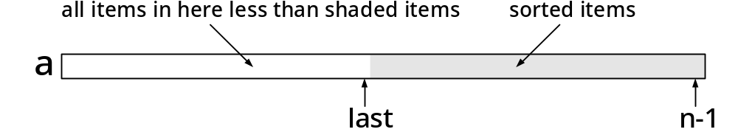
The operation of Selection Sort

Slide 6
Selection Sort
void selectionSort(int a[], int n)
{
int last(n-1);
int maxPos;
while (last > 0) {
// invariant: a[last+1] ... a[n-1] is sorted &&
// everything in a[0] ... a[last] <= everything in a[last+1] ... a[n-1]
maxPos = maxSelect(a, last+1); // last+1 is length from 0 to last
swapElements(a, maxPos, last);
last--;
}
}

Slide 7
Selection Sort example
A[0]
A[1]
A[2]
A[3]
A[4]
2
0
maxPos
5
n
7
3
1
currPos
5
6
4
last

Slide 8
Selection Sort example
A[0]
A[1]
A[2]
A[3]
A[4]
2
1
maxPos
5
n
7
3
1
currPos
5
6
4
last

Slide 9
Selection Sort example
A[0]
A[1]
A[2]
A[3]
A[4]
2
1
maxPos
5
n
7
3
2
currPos
5
6
4
last

Slide 10
Selection Sort example
A[0]
A[1]
A[2]
A[3]
A[4]
2
1
maxPos
5
n
7
3
3
currPos
5
6
4
last

Slide 11
Selection Sort example
A[0]
A[1]
A[2]
A[3]
A[4]
2
1
maxPos
5
n
7
3
4
currPos
5
6
4
last

Slide 12
Swap, after one pass
A[0]
A[1]
A[2]
A[3]
A[4]
2
1
maxPos
5
n
6
3
4
currPos
5
7
4
last

Slide 13
Selection Sort
A[0]
A[1]
A[2]
A[3]
A[4]
2
0
maxPos
5
n
6
3
1
currPos
5
7
3
last

Slide 14
Selection Sort
A[0]
A[1]
A[2]
A[3]
A[4]
2
1
maxPos
5
n
6
3
1
currPos
5
7
3
last

Slide 15
Selection Sort
A[0]
A[1]
A[2]
A[3]
A[4]
2
1
maxPos
5
n
6
3
2
currPos
5
7
3
last

Slide 16
Selection Sort
A[0]
A[1]
A[2]
A[3]
A[4]
2
1
maxPos
5
n
6
3
3
currPos
5
7
3
last

Slide 17
Selection Sort
A[0]
A[1]
A[2]
A[3]
A[4]
2
1
maxPos
5
n
5
3
3
currPos
6
7
3
last

Slide 18
Selection Sort
A[0]
A[1]
A[2]
A[3]
A[4]
2
0
maxPos
5
n
5
3
1
currPos
6
7
2
last

Slide 19
Selection Sort
A[0]
A[1]
A[2]
A[3]
A[4]
2
1
maxPos
5
n
5
3
1
currPos
6
7
2
last

Slide 20
Selection Sort
A[0]
A[1]
A[2]
A[3]
A[4]
2
1
maxPos
5
n
5
3
2
currPos
6
7
2
last

Slide 21
Selection Sort
A[0]
A[1]
A[2]
A[3]
A[4]
2
1
maxPos
5
n
3
5
2
currPos
6
7
2
last

Slide 22
Selection Sort
A[0]
A[1]
A[2]
A[3]
A[4]
2
0
maxPos
5
n
3
5
1
currPos
6
7
1
last

Slide 23
Selection Sort
A[0]
A[1]
A[2]
A[3]
A[4]
2
1
maxPos
5
n
3
5
1
currPos
6
7
1
last

Slide 24
Selection Sort
A[0]
A[1]
A[2]
A[3]
A[4]
2
0
maxPos
5
n
3
5
1
currPos
6
7
0
last

Slide 25
Result after each pass
A[0]
A[1]
A[2]
A[3]
A[4]
2
2
7
6
3
3
5
5
6
7

Slide 26
Result after each pass
A[0]
A[1]
A[2]
A[3]
A[4]
2
2
2
7
6
5
3
3
3
5
5
6
6
7
7

Slide 27
Result after each pass
A[0]
A[1]
A[2]
A[3]
A[4]
2
2
2
7
6
5
3
3
3
5
5
6
6
7
7

Slide 28
Result after each pass
A[0]
A[1]
A[2]
A[3]
A[4]
2
2
2
2
7
6
5
3
3
3
3
5
5
5
6
6
6
7
7
7

Slide 29
Result after each pass
A[0]
A[1]
A[2]
A[3]
A[4]
2
2
2
2
7
6
5
3
3
3
3
5
5
5
6
6
6
7
7
7

Slide 30
Result after each pass
A[0]
A[1]
A[2]
A[3]
A[4]
2
2
2
2
2
7
6
5
3
3
3
3
3
5
5
5
5
6
6
6
6
7
7
7
7

Slide 31
Result after each pass
A[0]
A[1]
A[2]
A[3]
A[4]
2
2
2
2
2
7
6
5
3
3
3
3
3
5
5
5
5
6
6
6
6
7
7
7
7

Slide 32
Result after each pass
A[0]
A[1]
A[2]
A[3]
A[4]
2
2
2
2
2
2
7
6
5
3
3
3
3
3
3
5
5
5
5
5
6
6
6
6
6
7
7
7
7
7

Slide 33
Analysis
Number of passes: n-1
  the first pass guaranteed to place 1 item
  the second guarantees a second
  the third a third, etc.
  After n-1 passes we have them all in place

Slide 34
Analysis: comparisons
In the first pass we compared n-1 pairs
In the second, n-2
In the third, n-3, etc.
Actual number of comparisons made across all passes, for this example was:
4+3+2+1 = 10

Slide 35
Order of complexity
The number of passes is O(n)
The number of comparisons in each pass is also O(n)
Therefore, the order of complexity of the sort is O(n*n) = O(n²)

Slide 36
Analysis of selection sort (con’t)
What if the list is sorted to begin with?
This selection sort is a mindless one
  it would not know that it should stop.
Best case and worst case are the same (except for the swaps)
The best, worst and average cases are all quadratic algorithms with O(n²)

Slide 37
Bubble Sort
Also n-1 passes
Also n-pass comparisons in each pass
Order of complexity is therefore n-squared
The same as the selection sort
The main difference is that swapping may occur as many as n-1 times on a single pass, with the selection sort it only occurs once, at the end of the pass.

Slide 38
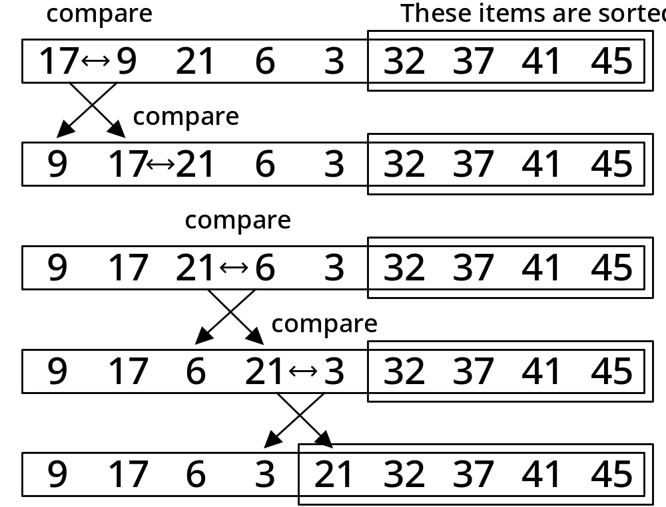
Example of one phase of Bubble Sort

Slide 39
bubbleSortPhase
// void swapElements(int a[], int maxPos, int last);
void bubbleSortPhase(int a[], int last)
{
// Precondition: a is an array indexed from a[0] to a[last]
// Move the largest element between a[0] and a[last] into a[last],
// by swapping out of order pairs
int pos;

Slide 40
bubbleSortPhase
for (pos = 0; pos < last - 1; pos++)
if (a[pos] > a[pos+1]) {
swapElements(a, pos, pos+1);
}
// Postconditions: a[0] ... a[last] // contain the same elements,
// possibly reordered; a[last] >= a[0] ... a[last-1]
}

Slide 41
Bubble Sort
void bubbleSortPhase(int a[], int last);
void bubbleSort(int a[], int n)
{ // Precondition: a is an array indexed from a[0] to a[n-1]
int i;
for (i = n - 1; i > 0; i--)
bubbleSortPhase(a, i);
// Postcondition: a is sorted
}

Slide 42
Version 1 of bubble sort
This version uses n-1 passes
During each pass, n-1 pairs are compared
Every time a pair needs to be swapped this is done before the pass can continue

Slide 43
Bubble Sort: difficult example
A[0]
A[1]
A[2]
A[3]
A[4]
7
0
Pos
5
n
6
Pos+1
5
3
2
4
last

Slide 44
Bubble Sort: difficult example
A[0]
A[1]
A[2]
A[3]
A[4]
6
0
Pos
5
n
7
Pos+1
5
3
2
4
last

Slide 45
Bubble Sort: difficult example
A[0]
A[1]
A[2]
A[3]
A[4]
6
0
Pos
5
n
5
Pos+1
7
3
2
4
last

Slide 46
Bubble Sort: difficult example
A[0]
A[1]
A[2]
A[3]
A[4]
6
0
Pos
5
n
5
Pos+1
3
7
2
4
last

Slide 47
Bubble Sort: difficult example
A[0]
A[1]
A[2]
A[3]
A[4]
6
0
Pos
5
n
5
Pos+1
3
2
7
4
last

Slide 48
Bubble Sort: difficult example
A[0]
A[1]
A[2]
A[3]
A[4]
6
0
Pos
5
n
5
Pos+1
3
2
7
4
last

Slide 49
Bubble Sort: difficult example
A[0]
A[1]
A[2]
A[3]
A[4]
5
1
Pos
5
n
6
Pos+1
3
2
7
4
last

Slide 50
Bubble Sort: difficult example
A[0]
A[1]
A[2]
A[3]
A[4]
5
2
Pos
5
n
3
Pos+1
6
2
7
4
last

Slide 51
Bubble Sort: difficult example
A[0]
A[1]
A[2]
A[3]
A[4]
5
3
Pos
5
n
3
Pos+1
2
6
7
4
last

Slide 52
Bubble Sort: difficult example
A[0]
A[1]
A[2]
A[3]
A[4]
5
0
Pos
5
n
3
Pos+1
2
6
7
4
last

Slide 53
Bubble Sort: difficult example
A[0]
A[1]
A[2]
A[3]
A[4]
3
1
Pos
5
n
5
Pos+1
2
6
7
4
last

Slide 54
Bubble Sort: difficult example
A[0]
A[1]
A[2]
A[3]
A[4]
3
1
Pos
5
n
2
Pos+1
5
6
7
4
last

Slide 55
Bubble Sort: difficult example
A[0]
A[1]
A[2]
A[3]
A[4]
3
0
Pos
5
n
2
Pos+1
5
6
7
4
last

Slide 56
Bubble Sort: difficult example
A[0]
A[1]
A[2]
A[3]
A[4]
2
0
Pos
5
n
3
Pos+1
5
6
7
4
last

Slide 57
Result after each pass
A[0]
A[1]
A[2]
A[3]
A[4]
7
6
5
3
2
2
6
5
3
2
3
3
5
3
2
5
5
5
3
2
6
6
6
6
2
7
7
7
7
7

Slide 58
Analysis
For this example, we made n-1 passes through the array
Each time we looked at n-1 pairs
The number of passes is O(n)
The number of pairs processed in each pass is O(n)
So, overall we get O(n*n) = O(n²)

Slide 59
Selection and Bubblesort comparison
Both are O(n²) sorts
If we count up the number of critical operations for both sorts, handling n-1, n-2, etc. pairs for each pass, using the data in the last example, we get
Selection sort: 10 comparisons
Bubble sort: 10 comparisons

Slide 60
What about swaps?
The same swap function can be used for both programs.
Let’s say it takes 3 operations, then the actual number of operations is
Selection sort: 10 + 3(n-1) = 22
Bubble sort: 10 + 3(10) = 40
The selection sort uses roughly half the number of operations as the bubble sort

Slide 61
Moral
Two sorts of the same order O(n²) may not be the same speed.
It depends on the data sets they are sorting.
It also depends on the way they are implemented.

Slide 62
Data sets
The data set we chose for the bubble sort was the worst one possible.
What happens if we run it on the data set we originally used for the selection sort?

Slide 63
Result after pass 1
A[0]
A[1]
A[2]
A[3]
A[4]
2
2
7
3
3
5
5
6
6
7

Slide 64
Result after pass 2
A[0]
A[1]
A[2]
A[3]
A[4]
2
2
2
7
3
3
3
5
5
5
6
6
6
7
7

Slide 65
Improvement needed
Neither the selection sort, nor the bubble sort know enough to stop if the list is sorted early!
We should be able to come up with a smart version of the bubble sort that can do this.
Instead of the outer for loop, let’s use a while loop that runs until the array is sorted.

Slide 66
Further improvements
We will also make sure the inner loop runs the minimum number of times (n-pass)
and that we keep track of whether a swap was needed for the pass we are on.
If a swap was needed then we cannot assume the array is sorted.
If a swap was not needed, then the array is sorted and we should send that signal to the outer loop.

Slide 67
Bubble sort improvements
What improvements can you suggest for the bubble sort that we have seen?

Slide 68
Improvements
Do not look at portions of the array that are already in sorted order
Leave when the array is sorted
  this is something the insertion and selection sorts we have seen could not do.

Slide 69
Improvements
How much of an operational difference does the smart bubble sort have over it’s dumb form?
How much of an operational difference does the smart bubble sort have over the selection sort?
Do these improvements make a difference in Big-O?
Which form of sort is best?

Slide 70
Bubble Sort
void bubbleSort(int a[], int n)
{ // Precondition: a is an array indexed from a[0] to a[n-1]
bool sorted(false); int pass(0);
while (!sorted) {
sorted = true;
for (pos = 0; pos < last - 1; pos++)
if (a[pos] > a[pos+1])
{ swapElements(pos, pos+1); sorted = false; }
pos++;
} // Postcondition: a is sorted
}

Slide 71
Result after pass 1
A[0]
A[1]
A[2]
A[3]
A[4]
2
2
7
3
3
5
5
6
6
7

Slide 72
Result after pass 2
A[0]
A[1]
A[2]
A[3]
A[4]
2
2
2
7
3
3
3
5
5
5
6
6
6
7
7

Slide 73
Analysis
Only two passes are made
4 pairs are checked on pass 1
swap is called 3 times on pass 1
3 pairs are checked on pass 2, no swaps
Total operations:
4+3+3 = 10
Better than the selection sort.
The savings would be even bigger for larger lists that were sorted early.

Slide 74
Bubble sort: final analysis
Not counting swapping, the best case is only n-1 operations!
Worst case is still n-squared
Order of complexity same as selection sort no matter what.

Slide 75

Equation 5-7

